Slide 1
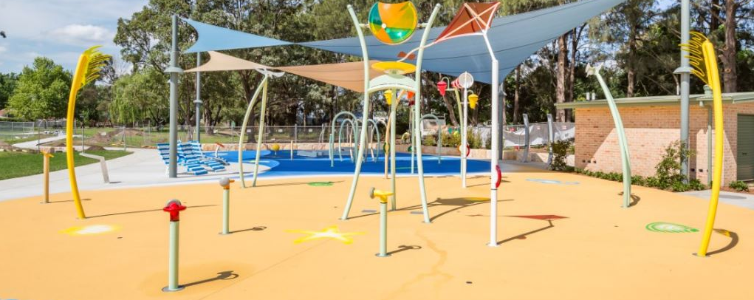
Draft Community Land Plan of Management Public Hearing | 17 July 2023

Slide 2
Acknowledgment of Country
Council acknowledges the Dharawal people as the traditional custodians of this land and pays our respect to their Elders both past and present.

Slide 3
The purpose of tonight
What does Public Exhibition involve?
Public Exhibition gives the community and opportunity to make comments and submissions in relation to a Draft PoM. The document will be on exhibition for 42 days, with submissions being open while the document is being exhibited. The PoM is made available online and at some Council locations.
At the conclusion of the public exhibition, Council will carefully consider each submission made and may decide to amend the PoM based on the submissions or to adopt the PoM as is.
What is a Public Hearing?
A public hearing is an opportunity for the community to have an input into the Draft PoM – individuals can speak or observe proceedings. Because this Plan of Management has the effect of Categorising Community Land, a Public Hearing is required.
JOC Consulting will record community feedback shared at the Public Hearing.

Slide 4
Who’s in the room
Councillors
Council staff
JOC Consulting staff
Community members

Slide 5
Agenda
Welcome and introduction by the Chair
Project background
Overview of the Plan of Management
Oral submissions by registered speakers
Overview of next steps by the Chair
Questions
Close of hearing

Slide 6
Background
The Local Government Act requires that Council has an Adopted Plan of Management (PoM) for Community Land. In 2016 the Crown Land Management Act added the requirement to adopt a PoM for Crown Land.
The Draft PoM has been in development since 2019
It covers both Council Owned and Crown Land which is managed as Community Land.

Slide 7
Overview of the PoM
The PoM covers the ongoing management and use of Community Land.
It is the tool to ensure the use of a Crown reserve is consistent with the Commonwealth Native Title Act 1993.
The PoM outlines objectives and performance targets for community land and promotes active land management and use.
Council is required to publicly exhibit the PoM to allow community involvement and representation in the contents of the plan.

Slide 8
Overview of the PoM
The PoM includes information on the use and management of each land category, including:
An overview of the land
The Core objectives of the land
Examples of Authorised Development and Authorised Use
Management Issues
Objectives and Performance Targets
Means of Achievement of Objectives
Manner of Assessment of Performance

Slide 9
Categorisation
The PoM categorises community land as either:
General Community Use;
Park;
Sportsground;
Natural Area; or
Area of Cultural Significance.
Natural Areas are further categorised as either:
Bushland;
Wetland;
Watercourse;
Escarpment; or
Foreshore.

Slide 10
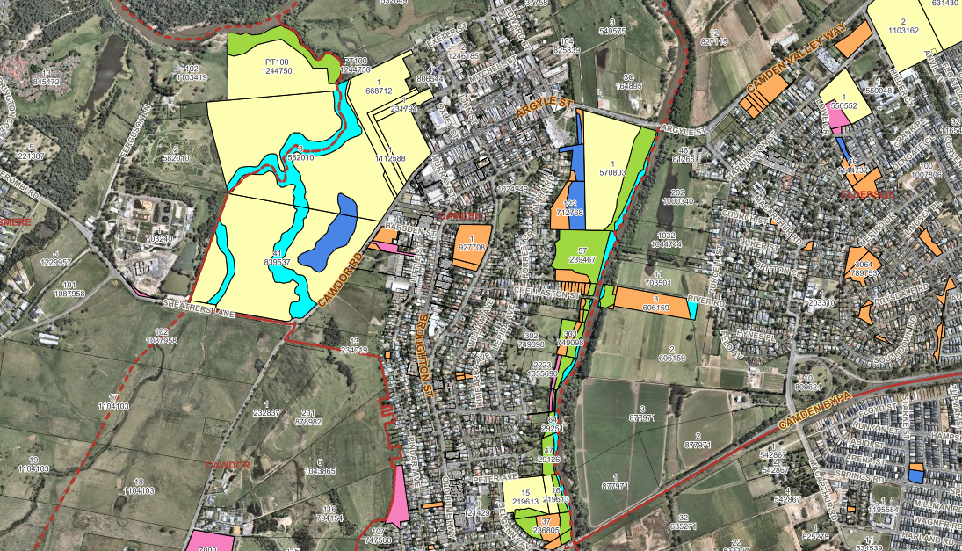
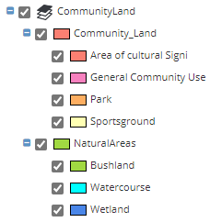
Categorisations
Mapping Example

Slide 11
Existing Plans of Management
Plan of Management | Adoption Date | Current Status
Gundangurra Reserve Plan of Management | 2004 | Will be superseded by Community Land Plan of Management 2023
Camden Bicentennial Equestrian Park/Onslow Park Plan of Management | 2005 | Will be superseded by Community Land Plan of Management 2023
Camden Riparian Areas Plan of Management | 2002 | Will be superseded by Community Land Plan of Management 2023
Lake Annan Plan of Management | 2014 | Will be retained
Herbert’s Hill Reserve Specific Area Plan of Management | 2015 | Will be retained

Slide 12
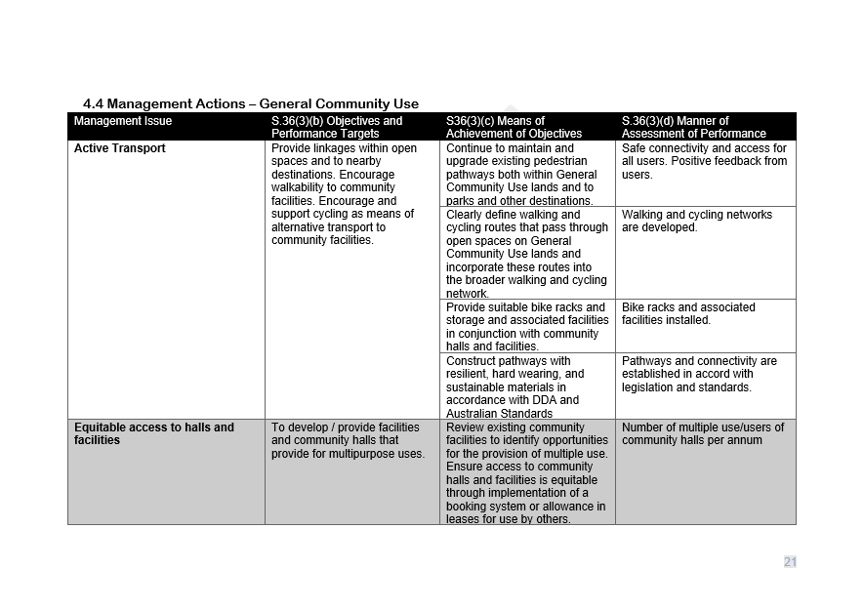
Example – Management Actions

Slide 13
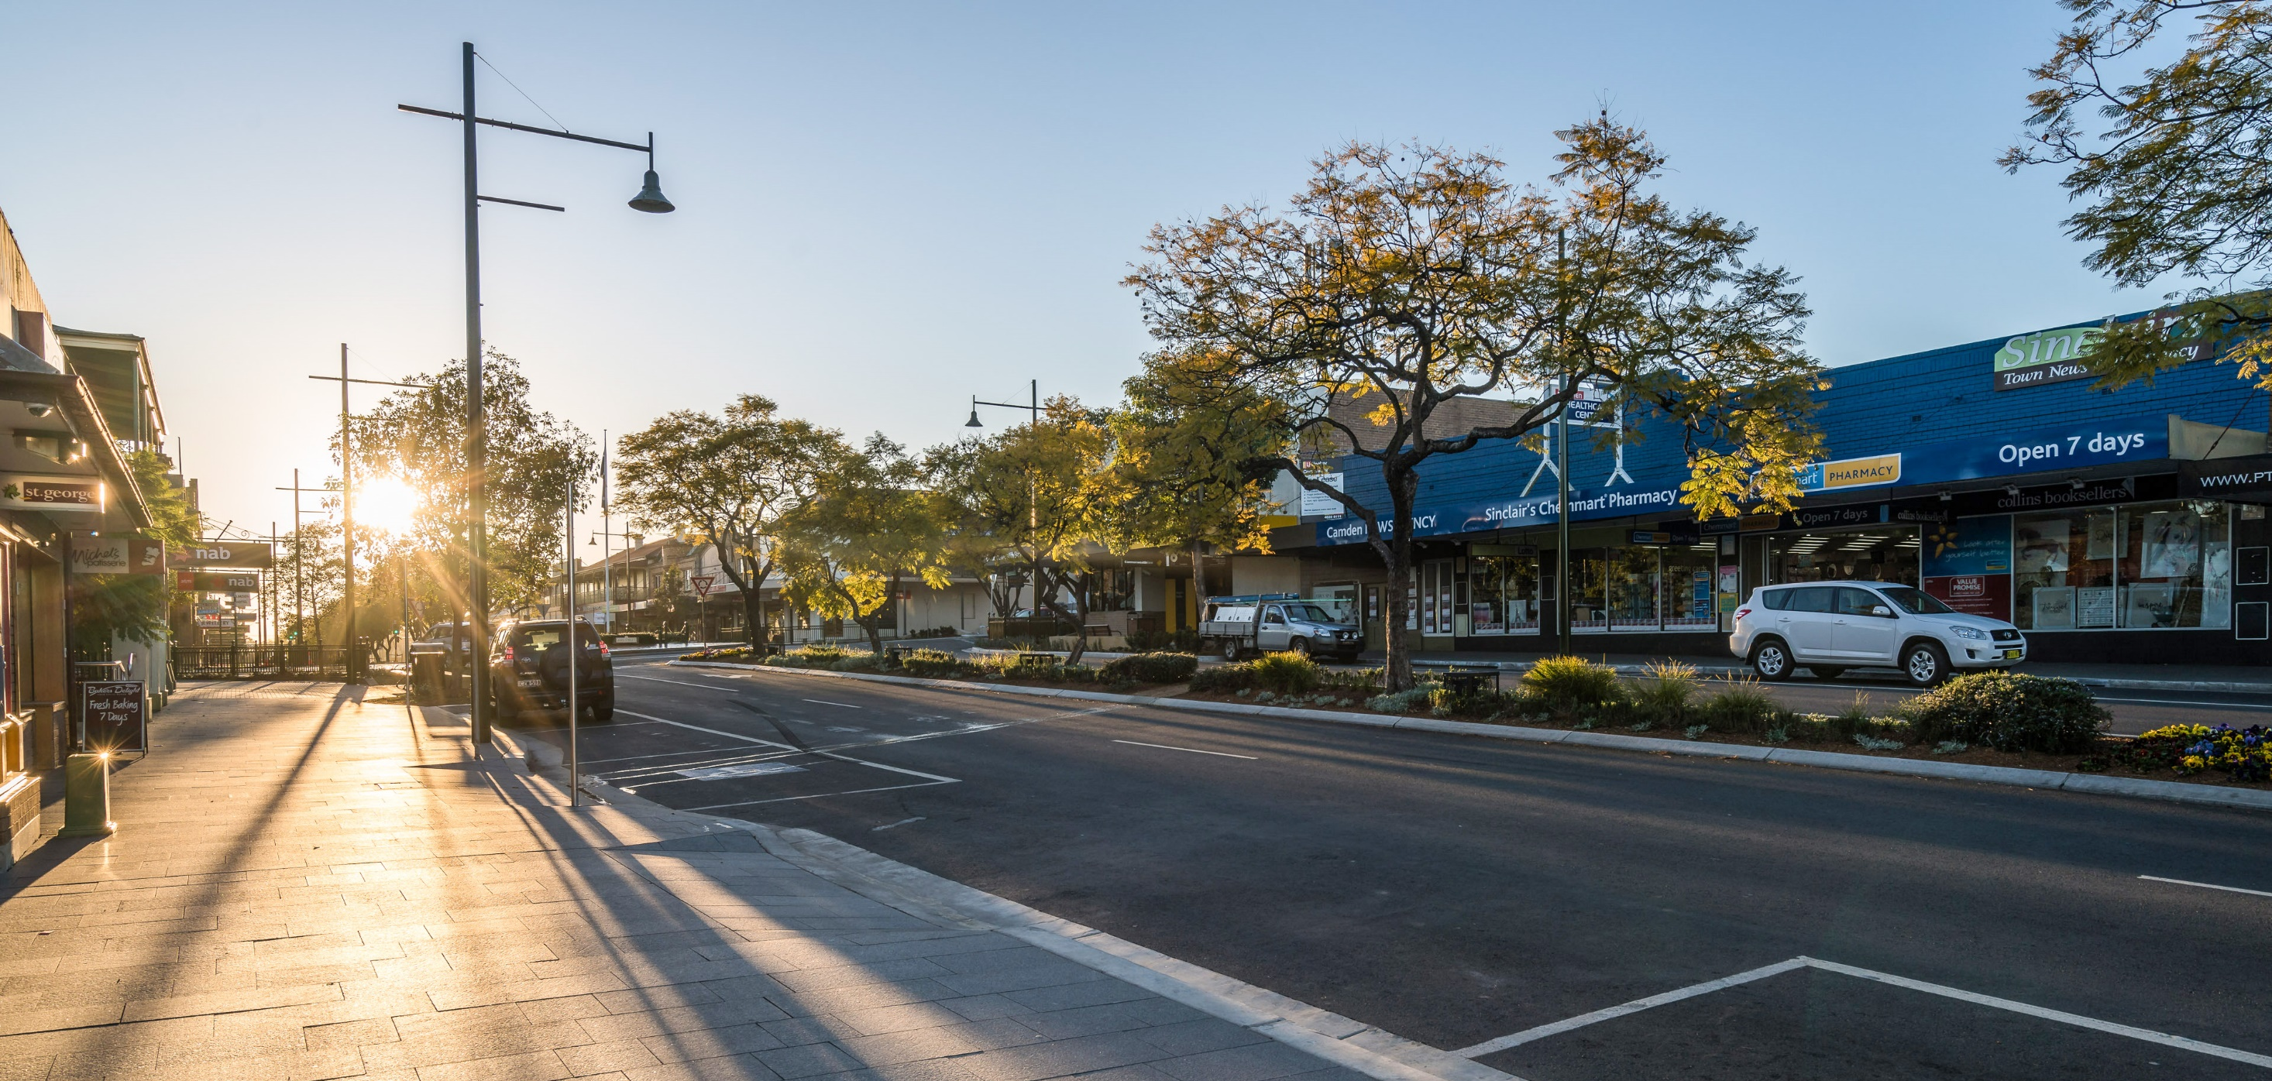
Any concerns, issues, ideas comments, questions or general feedback?
JOC Consulting will record.
Councillor Briefing

Slide 14
Adoption Process
Internal Council Review
Refer Draft PoM to Minister for Lands and Water
Undertake Public Exhibition (42 Day) and Public Hearing
Council to consider submissions made
Submit notice to Crown Lands advising of changes and seek permission to adopt
Council Resolves to adopt the PoM

